Slide 1
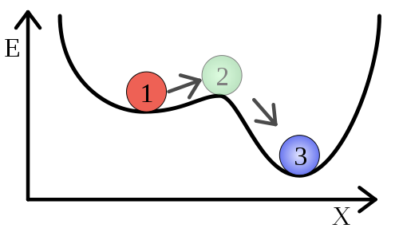

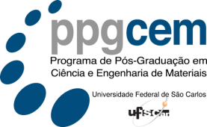
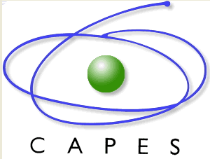
Universidade Federal de São Carlos
Centro de Ciências Exatas e de Tecnologia
Programa de Pós Graduação em Ciência e Engenharia de Materiais
Organizing Committee
6th International Workshop
of the PPG-CEM/UFSCar:
Tomaz Toshimi Ishikawa
Daniel Rodrigo Leiva
Metastability in New Metallic Alloys
Universidade Federal de São Carlos (UFSCar)
Centro de Ciências Exatas e de Tecnologia (CCET)
Programa de Pós Graduação em Ciência e
Engenharia de Materiais (PPG-CEM)
Departamento de Engenharia de Materiais (DEMa)
São Carlos – Brazil
May 2015

Slide 2
Programme
Announcement
The 6th International Workshop of the PPG-CEM/UFSCar: Metastability in New Metallic Alloys will be held in the city of São Carlos, São Paulo state, Brazil on the May 20th 2015 and will be hosted by the Graduate Program in Materials Science and Engineering (PPG-CEM) and Department of Engineering Materials (DEMa) at Federal University of São Carlos (UFSCar).
The main scope of this workshop is to bring to date for researchers, graduate and undergraduate students, some important topics related to metastability in new metallic alloys.
We are pleased to invite you to participate in this workshop and to discuss with national and international specialist recent research results as well as future directions in this field of materials science and engineering.
Date: Wednesday, May 20, 2015
Time: 8:30 AM – 12:00 PM
Where: Conference room at LCE – DEMa - UFSCar
Certificate: Everyone attending the workshop will receive a participation certificate issued by the organizers.
FREE Registrations – Please make your registration with Fernando fernando@ppgcem.ufscar.br
08:30–08:45 – Opening Ceremony
08:45–09:00 – Claudio S. Kiminami - FAPESP Thematic Project: Processing and Characterization of Amorphous, Metastable and Nanostructured Alloys (Departamento de Engenharia de Materiais, Universidade Federal de São Carlos, S.Carlos, SP, Brazil)
9:00 – 9:50 – Giorgos A. Evangelakis - The role of the microstructure in the properties of Zr-Cu model glassy alloys by Molecular Dynamics Simulations Department of Physics, University of Ioannina, Ioannina, Greece)
9:50–10:40 – Michael J. Kaufman - Factors Controlling the Formation of Metallic Glasses, Single-Phase Solid Solutions and Multi-Phase Structures in ‘High Entropy’ Alloys (Materials Science and Engineering Department, Colorado School of Mines, Golden, USA)
10:40 – 11:00 – Coffee Break
11:00 – 11:50 - André Costa e Silva - "Thermodynamic modeling and metastability in metallic alloys” (Escola de Engenharia Industrial Metalúrgica, Universidade Federal Fluminense, Volta Redonda, RJ, Brazil)
11:50 – 12:00 - Walter Jose Botta Filho Closing of the workshop (Departamento de Engenharia de Materiais, Universidade Federal de São Carlos, S.Carlos, SP, Brazil)

